Slide 1
Group 2: Pet Simulator Aoutul Nabi Purna thauhid ferdhous md Rahat sharker Shishir Dhar

Slide 2
AGENDA
Features
Important Classes
Problems Faced

Slide 3
Features

Slide 4
Notable Features of the program
Multithreading implemented
File Input and Output
GUI
All four OOP concepts implemented
Generics

Slide 5
Important classes

Slide 6
Notable Classes
Some classes that play pivotal roles:
Animal.java (Ancestor class of animals)
Custom.java (Common methods used in the whole project)
GameData.java (Saves and Reads data from external file)
GameGUI.java (Does what It says)

Slide 7
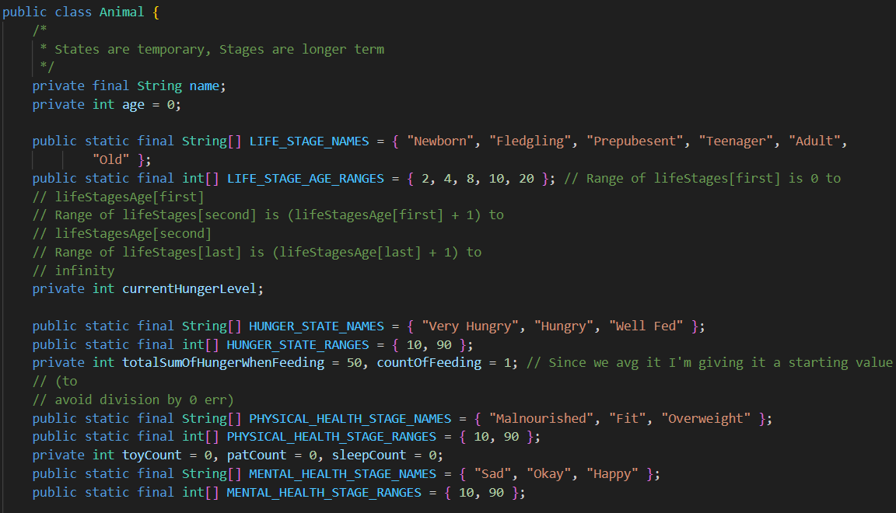

Slide 8
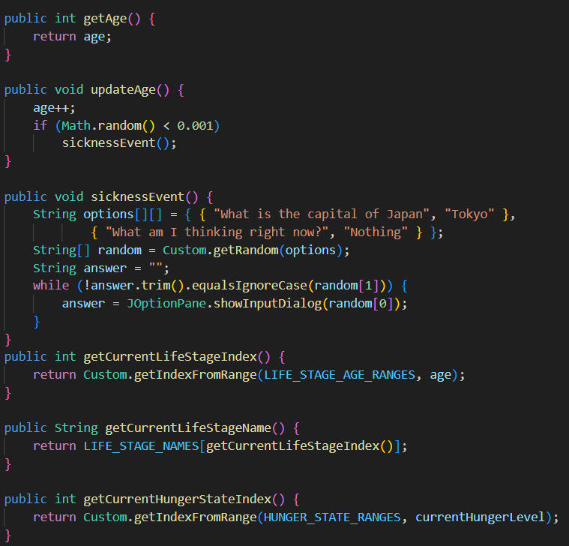
Reusing methods from the custom class

Slide 9
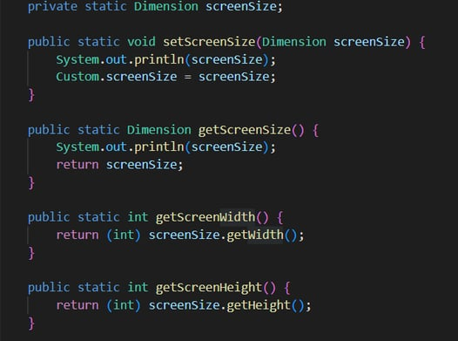

Slide 10
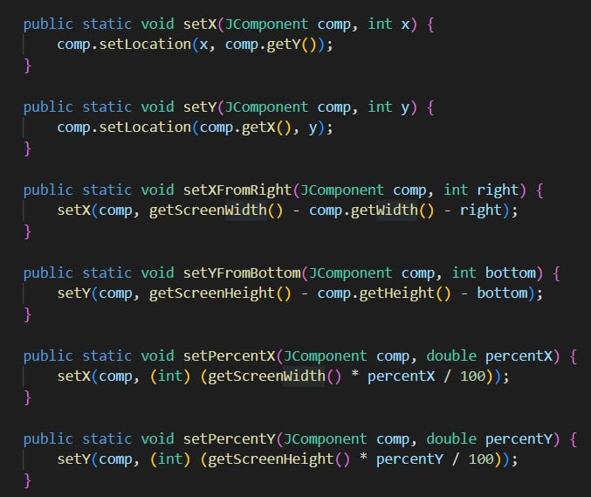

Slide 11
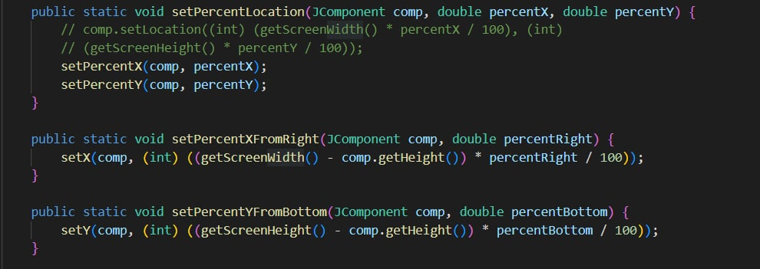

Slide 12
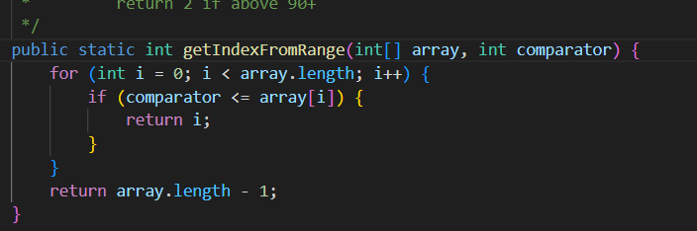
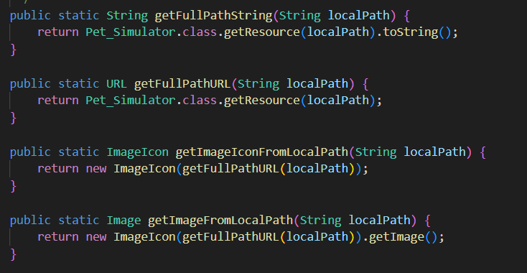
Returns the index we are at depending on the comparator
Getting image from path and forming new Image Icon (will be used in GUI)

Slide 13
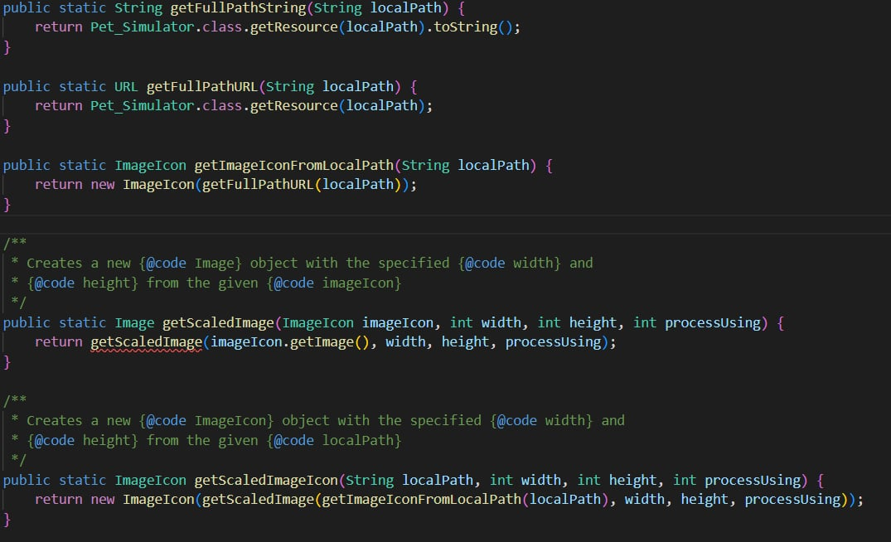

Slide 14
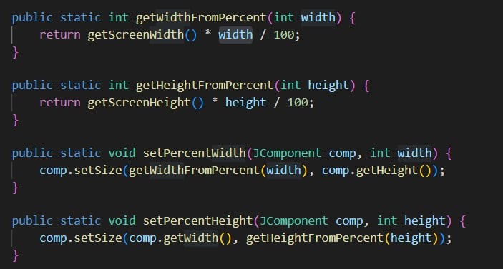
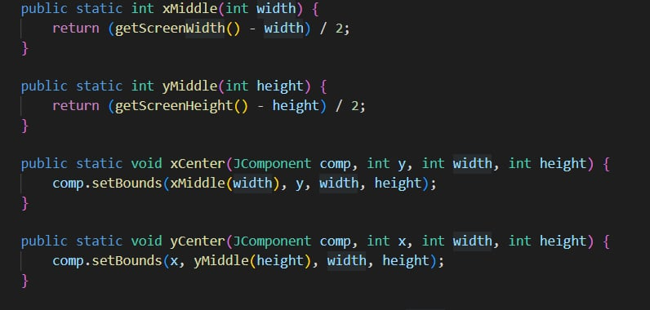
Methods commonly used in the GUI to make life easier
Will help with positioning the buttons later-on.

Slide 15
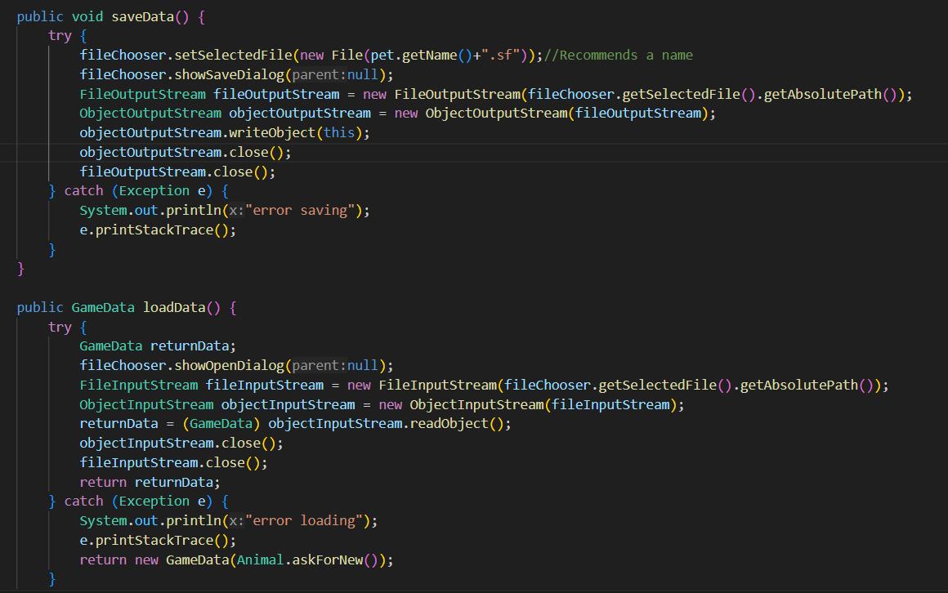
GAMEDATA CLASS
Storing data
Reading data

Slide 16
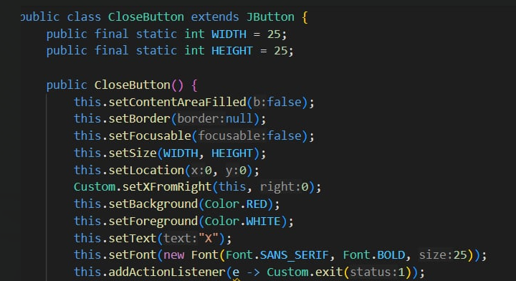
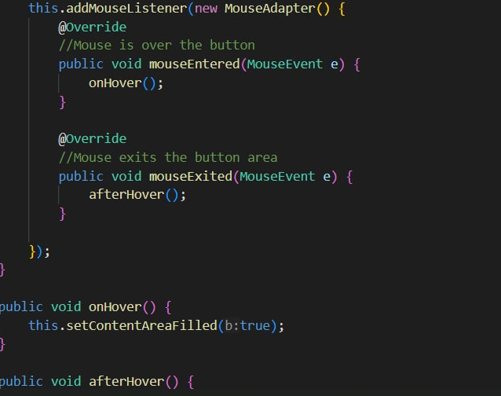
GAMEGUI

Slide 17
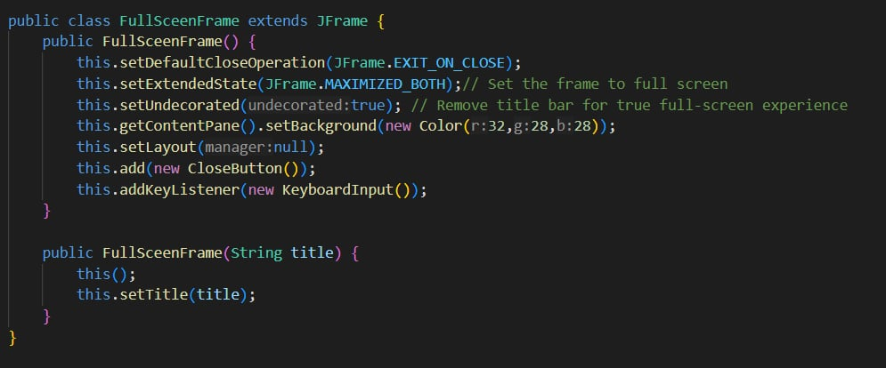
GAMEGUI

Slide 18
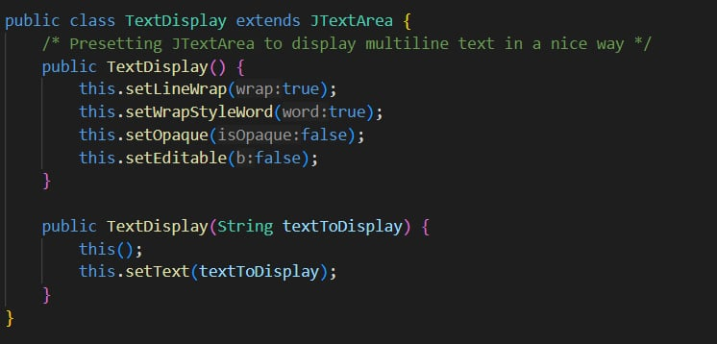
GAMEGUI

Slide 19
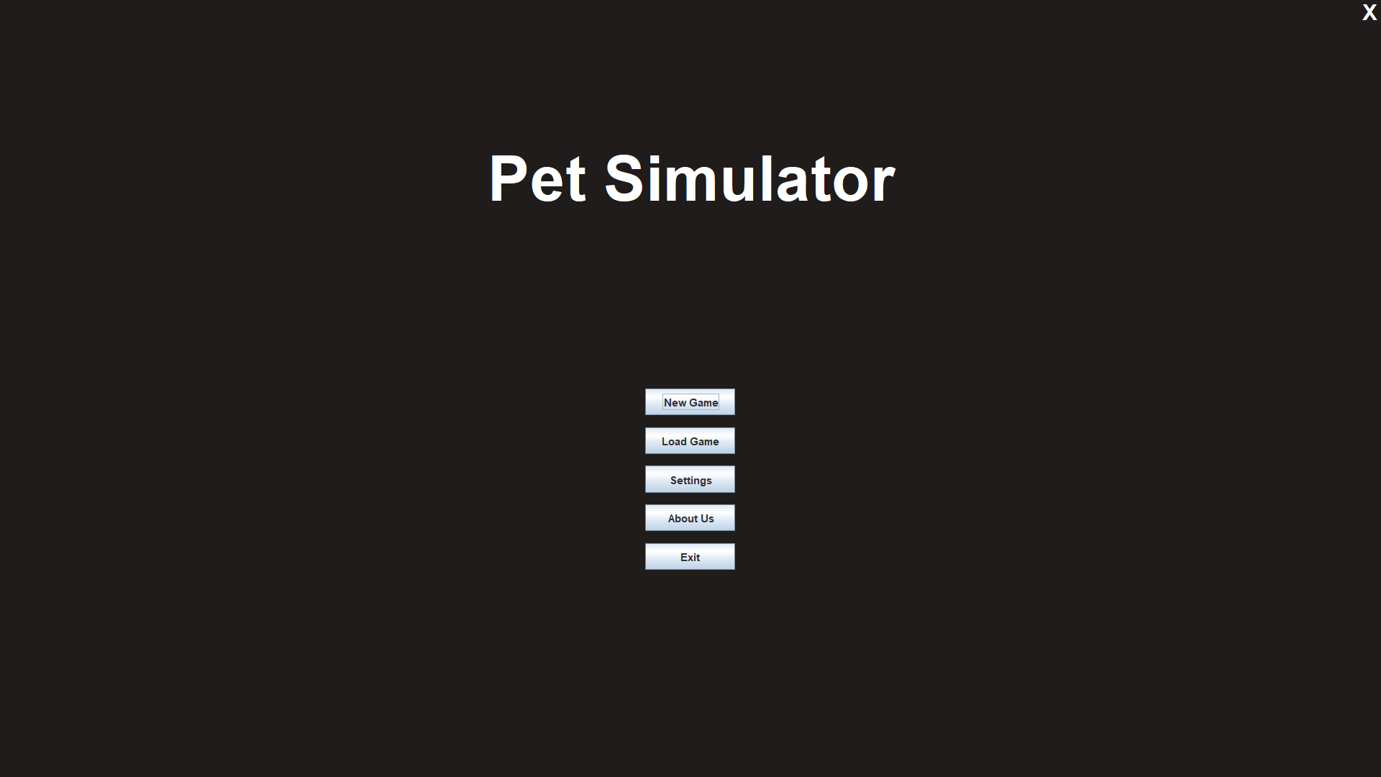
OUTPUT

Slide 20
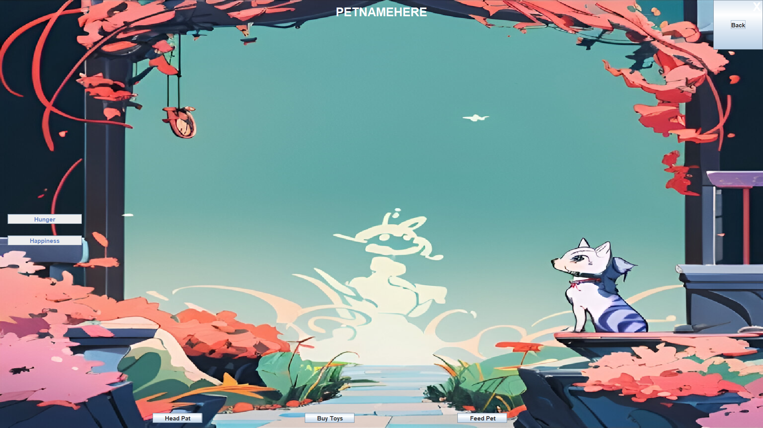
OUTPUT

Slide 21
Problems Faced

Slide 22
THANK YOU

